Slide 1
Welcome to the
Magellan Provider IBHS Workgroup
October 26, 2022

Slide 2
Welcome and Opening Remarks

Slide 3
Agenda
Updates from OMHSAS
Network Updates
Clinical Tidbits
OMHSAS Quarterly Report Results
Magellan’s Data Driven Process Updates
Upcoming Forums and Technical Assistance
Questions

Slide 4
Updates from OMHSAS

Slide 5
Public Health Emergency [PHE] extended to Jan 2023
The Department of Health and Human Services has extended the Federal Public Health Emergency an additional 90 days to mid-January 2023. A list of the regulations that were suspended in whole or in part and their current status is available here.
FAQ:
What is PHE?
PHE (Public Health Emergency) was issued at the beginning of the Covid-19 pandemic to make sure individuals would be able to receive Medical Assistance if needed.
Why is this important?
The Department of Human Services (DHS) is preparing for the federal COVID-19 PHE to end later this year. More details are expected to be shared by DHS over the next few months.
How can I get information and find out what I need to do to make sure my Medical Assistance continues?
Be sure to confirm your contact information is accurate with DHS by calling 1-877-395-8930
Go to dhs.pa.gov/phe
DHS will reach out to see if you are still eligible for MA
Individuals will have to complete a renewal to maintain MA coverage if you are eligible

Slide 6
Bright Start, Bright Kids, Bright Future
Office of Child Development and Early Learning (OCDEL) has a new resources, School Age Child Care (SACC) programs and the “School-Age Zone” inclusion in their newsletter. SACC related social-emotional resources and professional development opportunities will be created and OCDEL’s new SACC consultant will participate in SACC related stakeholder groups on a regular basis, as identified.
This newsletter focuses on sharing information on infant/early childhood mental health and the importance of relationship-based approaches and supports that help infants and young children feel safe, supported, and valued by the adults around them.
https://www.pakeys.org/iecmh/
Sign up for this newsletter:
https://www.pakeys.org/getting-started/about-us/newsletter-signup/

Slide 7
How do you handle when a master’s level clinician leaves mid-treatment?
Family would be offered the option to transfer or wait until provider can staff internally. This should be offered several times to member/caregiver depending on how long this need goes unstaffed.
Providers must continue to meet the regulatory standards around treatment planning, etc. If BHT/BHT-ABA is still in place, there needs to be clinical oversight.
If provider can meet these regulatory standards and the family wants to continue to wait to get full staffing from your agency, then this is fine. Otherwise, the options of discharge or transfer need to be discussed with the member/caregiver.

Slide 8
Field Office – Licensing Trends
Assessments should occur across settings.
Discharges aren’t meeting the regulatory requirements. The Magellan form is not necessarily all that’s expected for regulatory requirements, as it is used for all levels of care.
The 40 hrs of RBT training doesn’t cover the 30 hours of required training.
Staff doing supervision don’t understand what is being asked. Quality of supervision is not present.
Confusion of additional hr for BC-ABA who supervises a BHT.
Confusion around suspension regulations which do not include a waiver on direct observation.
Missing pieces of assessment. Missing the true intent of the assessment; answering the questions vs looking at what child/family really needs
Question of safe crisis management; many say no hands on but regs say that there is some expectations if there is an emergency.

Slide 9
Network Updates

Slide 10
Network Team
Mitch Fash – Network Manager – MFash@magellanhealth.com
Jess Pearce – Sr. Network Management Specialist – Cambria County- jpearce@magellanhealth.com
Michael Ditty – Network Management Specialist – Lehigh/Northampton Counties - msditty@magellanhealth.com
Crystal Devine – Network Management Specialist – Montgomery County - cedevine@magellanhealth.com
Jessica Torano – Network Management Specialist – Bucks County - toranoj@magellanhealth.com
Jeff Stumm – Network Management Specialist – Contracts/Credentialing - jrstumm@magellanhealth.com
Alyssa Gorzelsky – Claims Resolution Specialist – amgorzelsky@magellanhealth.com
Notes:
Crystal

Slide 11
Telehealth Code
On August 16, 2022, as a result of multiple requests for clarification regarding MA Bulletin OMHSAS-22-02, OMHSAS issued a Telehealth Frequently Asked Questions document.
In accordance with MA Bulletin OMHSAS-22-02, Magellan would like to advise providers that it is now able to accept informational modifier FQ when providing audio-only telehealth services. Effective for dates of service July 1, 2022, and beyond, providers should add informational modifier FQ in the last available position along with your current contracted code and modifier combination every time a service is provided over the telephone. Providers who offer services that currently require the use of four modifiers should continue to use those modifiers in accordance with your contract (four modifiers are the maximum allowable, so in this case, providers would not be able to utilize informational modifier FQ).
Magellan Updated Telehealth FAQ – October 6, 2022
https://www.magellanofpa.com/documents/2022/10/100622_telehealthfaq.pdf/
Notes:
Crystal

Slide 12
Satellite Sites & Licensing
IBHS licenses are issued regionally. There are 4 regional field offices: Western Field Office, Northeast Field Office, Southeast Field Office, and Central Field Office. A provider is only required to get multiple licenses if it provides services in multiple regions.
If a provider has multiple locations in one region, they do not need each site licensed, unless the site provides on-site services. However, your service description must include all locations under the regional license.
A provider is required to submit 1 service description for each IBHS license.
If a provider's service changes, an updated service description must be submitted to the licensing field office for approval. If a provider's address changes, a provider must notify OMHSAS's licensing field office and, if the provider is enrolled in MA, it must also notify MA enrollment.
*Not all locations in the region require MA enrollment unless providing on-site services.*
Notes:
Crystal

Slide 13
Availity Essentials
Availity Essentials
Nation’s largest real time health information network
20 years of streamlining and simplifying providers administrative tasks
“One Stop Shopping” Providers benefit from having one place to complete key task for multiple health plan payors
Availity Essentials is free so that providers can enjoy real-time information exchange with many payers they work with every day

Slide 14
Availity Summary
Who and Why Availity:
  Magellan Leadership made a strategic decision to enhance our provider on-line self-service capabilities.
  Availity is a nationwide, multi-payer Provider Engagement Portal helps providers and health plans collaborate and share information easily and efficiently.
  Availity is the nation’s largest real time health information network and meets the current digital standards being evaluated in the industry through the Council for Affordable Quality Healthcare (CAHQ)​.
  Over 2 million providers currently active on the Availity platform.
  Availity makes it easy to work with Magellan, from the first check of a patient’s eligibility through final resolution of the provider’s reimbursement.
Benefits to Magellan Providers:
  Providers benefit by having one place to go to accomplish key tasks for multiple plans, and health plans benefit as providers opt for self-service.
  Increase in provider satisfaction
  Increase provider engagement and utilization to handle provider transactions via the web.
  Free registration, Availity provider support and online access 24/7.
  *Check Provider Announcements page for an updated provider notice. https://www.magellanofpa.com/for-providers/
:

Slide 15
Availity Highlights
Get claims remittance and EOBs/EOPs via the Claims Status tile In addition to checking eligibility, benefits and accumulated amounts on Availity’s portal – Availity Essentials – you now have access to see claims remittance and EOBs/EOPs using the Claims Status tile. This goes live 11/1/22.
Specific communication will be sent to all providers with additional information and pre-recorded training opportunities.
MagellanProvider.com (MP.COM) is not going away at this time. Some tools will transition to Availity (Eligibility – 10/1/22 and Claims look up 11/1/22).
Submission of claims is not changing at this time only claims look up 11/1/22.
Authorizations are still the same for now but will transition to a new platform in the future. No date for this set but communications and trainings will occur prior to any changes.
CANS and POMS are still on MP.COM.

Slide 16
Clinical Tidbits

Slide 17
Assessment Reminders
General
Assessment shall include the following: − Strengths and needs across developmental and behavioral domains
Strengths and needs of family system
Natural supports
Specific services needed to support the child's needs −
Specific services needed to support parent/caregiver needs
Assessments must occur across settings. This is includes providing observational and measurable data in each setting!

Slide 18
Assessment – IBHS Required Components per the Regulations (Note that there are slight differences across IBH service types)
 | Example | Non-Example
Strengths/Needs across developmental domains and behavioral domains & Family System | *Includes overall description of family Member is at grade level academically but needs adult assistance to organize work materials and complete tasks as instructed. | Member like to play with water bins.
Natural Supports | Member's Aunt lives in same apartment and helps with childcare on a weekly basis. | Member may have Case Management but didn't have any information.
Specific services needed to support Member's needs & Parent/Caregiver Needs | Member has complex medical needs in addition to behavioral health needs and both the member and the family may need Case Management to assist in accessing resources and coordinating care. A referral was made to ___ after discussing and obtaining consent from ____. | The family needs a break because the Member stresses everyone out with their behavior.
Treatment History | Member received EI in the form of Speech and Occupational Therapy thru the I.U. from 1/21-1/22. Caregiver reports increased language and ... | I.U Happy Preschool Great Elementary School
Medical History | Member is diagnosed with ___ and is under the care of ___. Symptoms that may impact treatment and or need to be accommodated are as follows: ________________. Family history includes>>> | Member has a rare genetic disorder. Member has Autism (per Written Order but ADHD, Down Syndrome, etc. Are included in the Assessment).
Developmental History | Member walked at ___, spoke first words at ___, etc. | Member met all their milestones.
Social History | Member has had limited interactions with same aged peers due to ____. | Member has no friends at school.
Trauma History | Member witnessed DV between parents from 4-6 years old. The impact of this is reported to be observed in member's exaggerated response and distress when someone else is crying or yelling and refusal to sleep alone. Member has also made statements such as _____. | Member was in a car accident when they were 2 years old (and are now 12 years old).
Cultural, Language, Communication Needs | English is the second language across most family members in the home. Needs discussed were program materials in both languages and the use of a translator during evaluation and treatment plan meetings. | The member is non-vocal. The family recently immigrated from Haiti and have difficulty understanding English when spoken. There are no cultural/language/communication needs.

Slide 19
Assessment – IBHS Required Components per the Regulations (Note that there are slight differences across IBH service types)
 | Example | Non-Example
Functioning – Current levels across Developmental, Cognitive, Communicative, Social and Behavioral Functioning | Information summarized from Structured Clinical Tool such as the ABAS-3, Vineland 3, etc. and direct observations of member in all relevant settings. *Please note that if recommending ABA BC-ABA and MT, information that corresponds to each service and the qualified clinician needs to be represented clearly and distinctly. | Member is not functioning well per parent report.
Structured Clinical Tool | Summary of results reported in data summary table, report of measurable Baseline Levels across target behaviors, etc. *See next slide for minimum requirements when using an FBA as the Structured Assessment Tool. | See attached printout of Assessment.
Summary of Treatment Recommendations | Written Order recommends up to 15 hours per month of BC and up to 50 hours per month in the home and or school/daycare settings. Based on the members and family's assessed needs in all relevant settings and in consideration of treatment barriers, the following is recommended for the Member: BC 12 hours per month BHT 20 hours per month home/community BHT 25 hours per month daycare (Happy Preschool) These services are expected to …. Behavior Therapy – meaningful changes, that improve quality of life, increase access, establish functional skills, increase independence (CCBH) | Written Order recommends up to 25 hours per month of BC-ABA only in the home/community. Member is recommended to receive 150 hours per month across home/school and camp as needed (observations only occurred in the home setting, no information about school or camp). BC is recommended to train caregivers on interventions. MT is recommended to teach emotions. Behavior Management – manages the reported concern with no expectation of behavior change, no plan for generalized responding or responsiveness to natural cues, fosters dependence (CCBH)

Slide 20
FBA Minimum Requirements
To be used as the required Structured Tool (and more importantly, to be useful in determining why a target behavior is occurring and preliminary information as to how to change the behavior), an FBA must include the following, at minimum:
, asks the
 | Example | Non-Example
*Assessor | BC/MT/GLP/BC-ABA/BA has specific training and demonstrated competency in conducting FBA's for the target population served. | BC/MT/GLP/BC-ABA/BA has never conducted an FBA independently and is given a worksheet with the steps outlined as a resource to complete one.
Indirect Assessment | The Assessor meets with parents and completes Functional Assessment Interview and after reviewing the FAST and identifying ONE target behavior with a specific, observable and measurable description, asks the parents to complete one. The same target behavior is identified in school and the Assessor reviews the FAST form and asks the teacher to complete the form for the same behavior. | The Assessor lists all target behaviors reported on the intake form and asks the Parents to complete a FAST, the teacher to complete an MAS and the daycare provider to complete a QABF.
Direct Assessment | The Assessor uses the Indirect Assessment information to inform them of where and when they will schedule direct observations of the target behaviors identified. Multiple observations across a 2 week time period. The member is not permitted to return to daycare without a support staff, so the Assessor schedules an opportunity to observe the daycare activities and schedules a trip to the park when other children are present with the parent to determine potential needs in group contexts, with peers, outside the home. | The Assessor only conducts an observation one time during a Telehealth session in the home.
Interpret/ Analyze Data | The Assessor uses the data collected to determine a hypothesized function and relevant antecedent and consequent variables - Positive Reinforcement: Attention, Access, Automatic Negative Reinforcement: Escape, Automatic Setting events represent factors that influence the probability that the behavior will occur aside from immediate antecedents. | The Assessor determines that member destroys work materials for Sensory input when they are having bad thoughts. Setting events identified are home and school.

Slide 21
Daycare/Preschool – Wanting FT BHT/BHT-ABA
Has your agency had this experience where a daycare/preschool/school has requested full time “1:1” support of a member otherwise the child cannot attend?
What does the data say?
What do the regs say?
What is the clinical best practice?
How has your agency handled this situation?

Slide 22
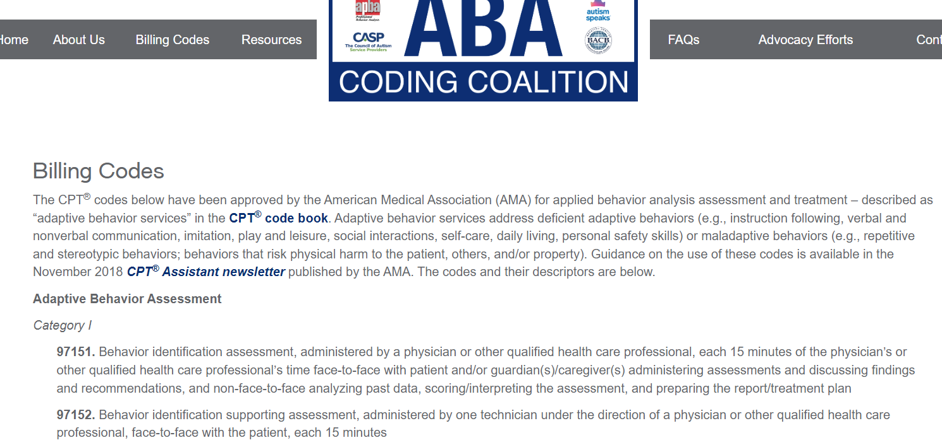
ABA Billing Codes Resource
Remember to check your contract for the ABA codes & modifiers available. This resource can offer some additional information about what is entailed for each code.
https://abacodes.org/codes/

Slide 23
New Groups under IBHS
*Please only initiate this process when your agency is ready to begin implementing group services if approved. A provider cannot use their ABA Group codes on their fee schedule unless the agency goes through this process first.
For those who are interested in delivering IBHS Group Services, please follow the following process:
Submit a detailed program description to IBHS@MagellanHealth.com inclusive of:
  target population (including primary & MA secondary participants)
  clinical model of program
  size of each group
  frequency of each group
  length of group (program duration and each sessions)
  if group is closed or open
  location of group
  family involvement
  Authorization period
  other relevant information
Magellan will schedule a Technical Assistance (TA) call to review your program proposal.

Slide 24

Magellan of PA website – Live demo
How do I find what I’m looking for?
Provider IBHS webpage Forms Provider Manual

Slide 25
OMHSAS Quarterly Report

Slide 26
Assessment Averages
County | Service | Ax Mean Q1 2022 | Ax Mean Q2 2022
All | Individual | 16.6 | 17.82
All | ABA | 21.14 | 24.97
Individual Assessment Regulation = 15 days
ABA Assessment Regulation = 30 days

Slide 27
Individual Assessment Mean by County – Q1 & Q2 2022
County | Mean Q1 2022 | Mean Q2 2022
Bucks | 15.9 | 11.8
Cambria | 16.12 | 25.5
Lehigh | 12.27 | 13.1
Montgomery | 20.15 | 22.9
Northampton | 18.57 | 15.8

Slide 28
ABA Assessment Mean by County – Q1 & Q2 2022
County | Mean Q1 2022 | Mean Q2 2022
Bucks | 16.75 | 16.8
Cambria | 20 | 30.5
Lehigh | 21.68 | 26.8
Montgomery | 26.74 | 29.4
Northampton | 20.56 | 21.35

Slide 29
Written Order without an Assessment
Total # of Members with a Written Order (billed WO claim)
awaiting an Initial Assessment at the end of Quarter 2 2022:
46
Bucks 14
Cambria 2
Lehigh 6
Montgomery 9
Northampton 15

Slide 30
IBHS Assessment, No Treatment Yet
Total # of Members with an IBHS Assessment
awaiting to start treatment at the end of Quarter 2 2022:
66
Bucks 30
Cambria 5
Lehigh 16
Montgomery 10
Northampton 5

Slide 31
Individual Treatment Started During Q1 2022
Total # of Members who started Individual IBHS treatment
during Quarter 1 2022:
193
Bucks 69
Cambria 20
Lehigh 35
Montgomery 46
Northampton 23

Slide 32
ABA Treatment Started During Q1 2022
Total # of Members who started ABA IBHS treatment
during Quarter 1 2022:
47
Bucks 7
Cambria 2
Lehigh 15
Montgomery 15
Northampton 8

Slide 33
Individual Treatment Started During Q2 2022
Total # of Members who started Individual IBHS treatment
during Quarter 2 2022:
153
Bucks 48
Cambria 14
Lehigh 24
Montgomery 43
Northampton 24

Slide 34
ABA Treatment Started During Q2 2022
Total # of Members who started ABA IBHS treatment
during Quarter 2 2022:
53
Bucks 10
Cambria 3
Lehigh 9
Montgomery 20
Northampton 11

Slide 35
153 members admitted & 162 discharged in Q2 2022

Slide 36
53 members admitted & 71 discharged in Q2 2022

Slide 37
Total # of Members who started Treatment Q1 & Q2 2022
Individual Services
346
Bucks 117
Cambria 34
Lehigh 59
Montgomery 89
Northampton 47
ABA Services
100
Bucks 17
Cambria 5
Lehigh 24
Montgomery 35
Northampton 19
446 Magellan members started Individual or ABA Services from January-June 2022

Slide 38
Magellan’s Data Driven Process Updates

Slide 39
CLINICAL MEASUREMENT TOOL
  In Q3, Care Managers reviewed 287 member packets using our Clinical Measurement Tool.
  Dr Siegler and the IBHS team completed over 60 Collaborative Case Review discussions.
  During October, the team is putting together all the data and will present each provider with a Feedback Form by county served.
  The Feedback Form will show the member’s total scores.
  It will also show the data as a whole on each section: Written Order, Assessment, Individual Treatment Plan, Coordination of Care, CANS, MNG, and overall Total Score.
  At the bottom, the Feedback Form will also check off whether the Care Manager is requesting a meeting to go over our findings.

Slide 40
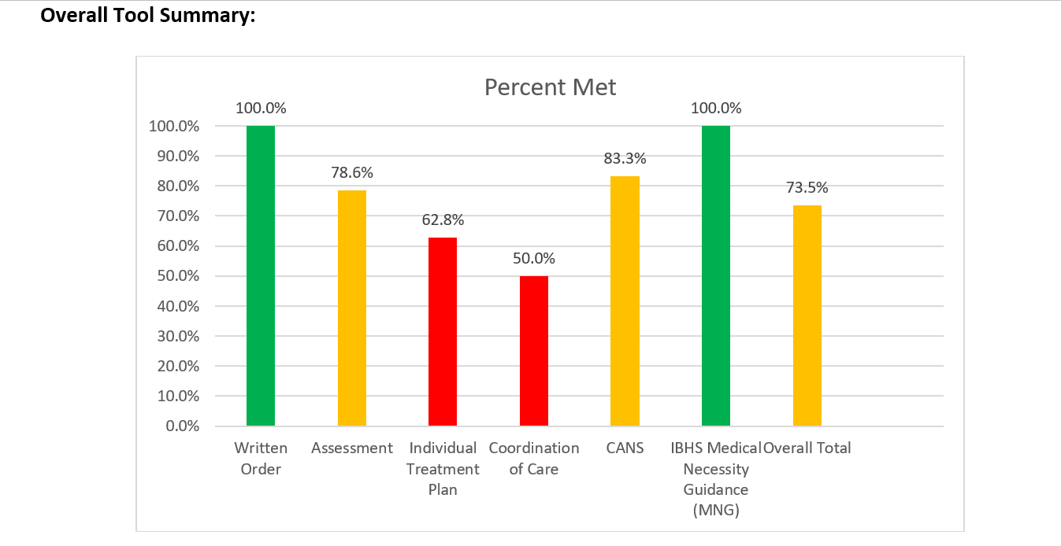
Sample Feedback Form

Slide 41
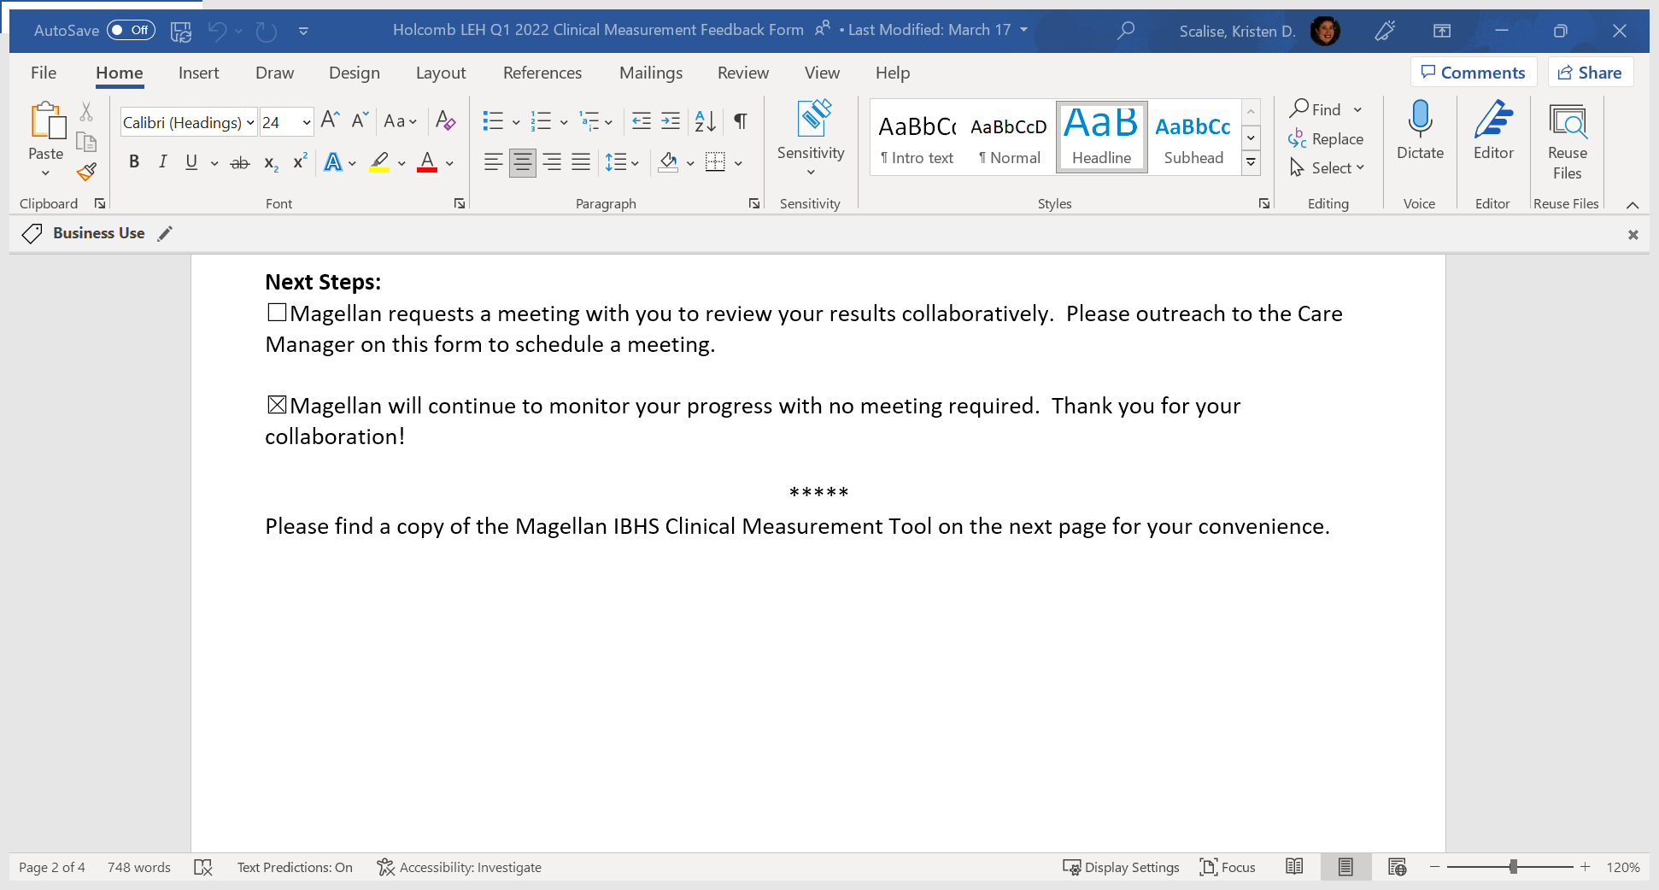
Sample – Request a meeting to review

Slide 42

Provider Initiated Phone Calls for FBS
Recommendations
Telephone call with Magellan Care Manager when considering a FBS referral.

Slide 43

Higher Level of Care Collaborative Phone Call
Magellan Care Manager will outreach provider for any IBHS member who is discharged from Acute Inpatient Program or Residential Treatment Facility within prior 30 days.
Goal: To ensure supportive transition from 24-hour level provider to community-based provider.

Slide 44
Upcoming Forums &
Technical Assistance

Slide 45
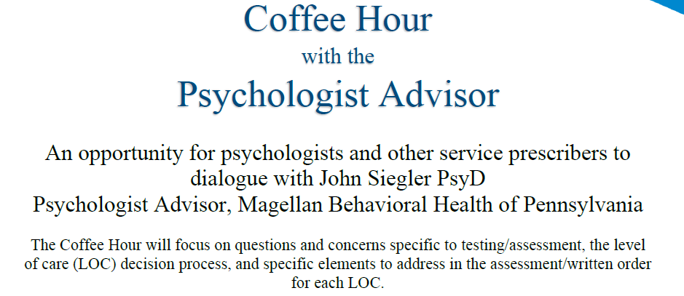
Date: Wednesday, January 11, 2023
Time: 12:00 P.M – 1:00 P.M.
Location: Zoom
There will be registration. Keep eyes out for upcoming flyer.
Notes:
John

Slide 46
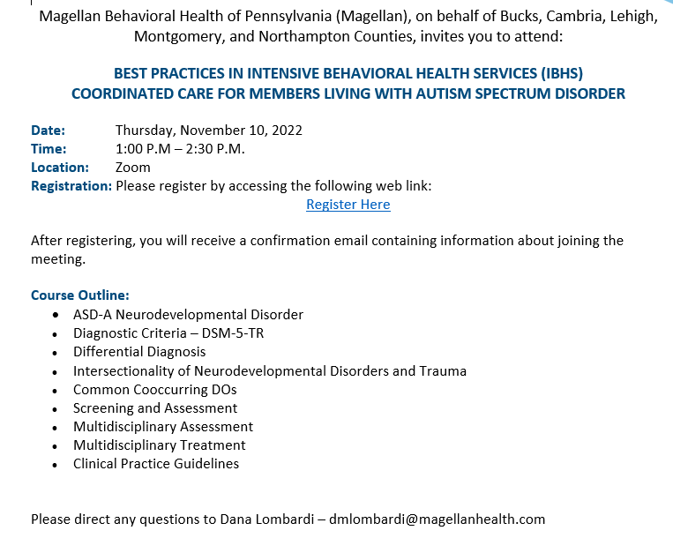
Dr Siegler’s Next Best Practices’ Training
Notes:
John

Slide 47
Q4 2022 IBHS Provider Forum
Wednesday, January 25, 2023, 9:00 to 11:00 A.M. Via Zoom
Register in advance for this meeting (click Ctrl+Link):
https://magellanhealth.zoom.us/meeting/register/tJAvfuitrzsrGtMuUjKoafRmsHk5rxsEuYAS
After registering, you will receive a confirmation email containing information about joining the meeting.
No invites are sent. This info can always be found at the bottom of our
IBHS provider webpage:
https://www.magellanofpa.com/for-providers/services-programs/intensive-behavioral-health-services-ibhs/

Slide 48
Questions?

Slide 49
Resources
FBA Training
  https://www.pattan.net/getmedia/eca12015-858b-4448-962d-753816d71e20/FBA_ProcessBklt0516
  ODP-20-081-Functional-Behavioral-Assessment-Virtual-Training.pdf (provideralliance.org)

Slide 50
Thank you!

Slide 51
Confidentiality Statement for Providers
The information presented in this presentation is confidential and expected to be used solely in support of the delivery of services to Magellan members. By receipt of this presentation, each recipient agrees that the information contained herein will be kept confidential and that the information will not be photocopied, reproduced, or distributed to or disclosed to others at any time without the prior written consent of Magellan Health, Inc.
The information contained in this presentation is intended for educational purposes only and should not be considered legal advice. Recipients are encouraged to obtain legal guidance from their own legal advisors.

