Slide 1
Magellan’s Clinical Practice Guidelines (CPGs)
July 26, 2023
Emily Whaland, ms, lpc
Notes:
Hi everyone! Good morning. My name is Emily Whaland and I will be presenting the Clinical Practice Guidelines Training this year. My role here is the Lead Autism Care Manager on Children’s Community Based Support Team. I like to switch up this training each year with new content- so it’s my hope this will serve as both a refresher and an opportunity to learn something new about our CPG’s. Please hold all questions until the end.

Slide 2
Objectives for this Training
1
Introducing the Clinical Practice Guidelines
Understanding the Clinical Practice Guidelines
2
3
Applying the Clinical Practice Guidelines
4
Finding the Clinical Practice Guidelines
Notes:
I am hopeful we will cover areas where you may have further questions as well as have this serve as a nice refresher training to the CPG’s. These are the objectives for this training.
Introducing the CPGs
Understanding the CPGS
Applying the CPGs
Finding the CPGS

Slide 3
Introducing the CPGs
Notes:
I usually like to start my trainings with a poll but because this is a very content heavy training, Please pick an emoji that represents your thoughts on the CPGs (i.e., happy- I understand, use this, got this, sad- im not so sure)

Slide 4
What are the CPGs?
Magellan uses evidence-based clinical practice guidelines (CPGs) as clinical decision support tools that guide providers, members, and Magellan’s clinical staff in determining the management and clinical appropriateness of services in specific clinical circumstances for the treatment of acute and chronic behavioral health conditions relevant to the needs of Magellan’s member population.
Notes:
For those that are new to Magellan or need a little refresher we are going to review what the clinical practice guidelines are
Let’s ask ourselves first- what are the CPG’s
Evidenced based guideline to help determine the clinical appropriateness of services
They should target accurate/chronic behavioral health conditions
Can be used by us, providers, and members to guide their tx
Magellan develops or adopts clinical practice guidelines to assist providers in screening, assessing and treating common disorders.
Prior to adopting each guideline, a multi-disciplinary panel—including board-certified psychiatrists and clinical staff—examines relevant scientific literature and seeks input from network providers as well as consumers and community agencies.
Once implemented, Magellan reviews each guideline at least every two years for continued applicability and updates guidelines as necessary.

Slide 5
Why CPGs?
CPGs exist in all of healthcare, not just behavioral health
Based on scientific evidence, review of the medical/psychiatric literature, or appropriately established authority
A means to standardize treatment options with the most effective interventions available
Help ensure quality care and care management
Support the use of evidence-based practices
Ideal for helping both practitioners and patients make healthcare decisions in specific circumstances
Systematically developed, based on the best evidence and the most current data
Identify what is a standard, acceptable practice or intervention vs what is outdated, experimental, speculative, or on the “fringe”
Licensing regulations only establish the minimum standards
Notes:
CPG is a universal system- it is not just relevant to Behavioral Health
As you hear me reference in my Autism Training- the Clinical Practice Guidelines were just updated by the American Academy of Pediatrics in December 2019. This is just one example of a CPG outside behavioral health field and these are actually adopted into our Autism CPG
When we think of the words “Clinical Practice Guidelines” we want to associate it with evidenced based practices. These are meant to help guide providers and members to making healthcare decisions. These evidenced based practices are systematically developed and based on data driven research and findings. Think about when you were back in grad school or in your bachelor's program- professors always wanted accredited research journal articles to support our findings as well as most current and up to date research. Keep that same clinical hat on while thinking about the CPG data and research used to form these guidelines.

Slide 6
Limitations of CPGs
CPGs are intended as reference guides to assist providers in the diagnosis and management of selected conditions.
CPGs cannot substitute for the individual judgment brought to each clinical situation.
CPGs may not apply to every person or clinical situation. Some variation is expected. Provider judgment and knowledge of an individual supersedes any clinical guidelines.
CPGs do not determine insurance coverage of health care services . Coverage decisions are based on member eligibility, contractual benefits, and determination of medical necessity.
Notes:
These CPG’s do have limitations. Although we are using the most current research to developed evidenced based practices- there are other factors that still come into play when choosing a treatment path.
As a whole- we still need to consider individualized treatment needs.
We also need to see if the treatment approach selected meets criteria through our medical necessity. This will also vary based on a members eligibility, benefits, and MNC for the LOC needed.
So again, the CPG’s serve as a reference guide but not a final determination for the appropriate treatment step.

Slide 7
Conditions for which Magellan has CPGs
Acute Stress Disorder and PTSD
ADHD
Autism Spectrum Disorders
Depression
Managing Suicidal Patients
Schizophrenia
Substance Use Disorders
Previously Adopted Guidelines
Bipolar Disorder
Eating Disorders
Generalized Anxiety Disorder
OCD
Panic Disorder
Notes:
These are all listed on our provider website. As for the previously adopted guidelines; These clinical practice guidelines were previously adopted by Magellan. They remain available to providers as portions of content remain relevant to current clinical practice. These were recently changed so please go and check them out and refresh yourself- they are not the same as what I presented on last year.
When we get to the understanding section of the CPGs- each section is designed to be a little different in regards to what information you can pull from these guides. Some will cover stats, others will cover interventions, and some will cover quick reference guides and tip sheets that can be used for easy access.

Slide 8
Understanding the CPGs
Notes:
For the next few slides- I am going over the adult results of the CPG and how it impacts our work and the work of our providers.

Slide 9
CPG Audit 2022: Results & Improvements
85% benchmark was met across 4 of the 5 audit tools
  SUD was not met at 67%
Increased variability when compared to the last four years of CPG audits
Increased Scores: ADHD, Schizophrenia, Suicide Risk
Decreased Scores: Major Depression, SUD
Audit Tool | CPG - TRR | CPG- Suicide Risk | CPG- ADHD | CPG- Major Depression | CPG- Schizophrenia | CPG- Substance Use Disorder
2019 | 86.07% | 100.00% | 88.75% | 89.81% | 89.26% | 88.13%
2020 | 89.02% | 92.66% | 89.78% | 95.20% | 82.76% | 86.62%
2021 | 84.41% | NA | 88.67% | 90.04% | 87.39% | 88.58%
2022 | 85.33% | 93.48% | 98.06% | 86.44% | 95.45% | 66.62%
Notes:
Through the TRR review process, Magellan explored if providers had implemented national CPGs for use with the member population. Results are expected to be >85%. Those not meeting goal were addressed via action plan. This goal was met. In 2022, fifty-five (55) CPGs audit tools were completed as part of the TRR process. From applicable TRR opportunities, there were 981 member records reviewed against applicable CPGs. Those 981 member records supported 55 provider CPG reviews.
85% benchmark was met across 4 of the 5 audit tools with a range of 67% to 98%. The previous year ranged from 83-93% so you can see there is a lot more variability in the range.
*****I did want to note that no charts were reviewed for SI risk in 2021 which would cause a false correlation for a true increase in the SI risk score, but it still had increased from 2020 scores. SI CPG is only completed when there is active SI encountered in a mbr’s chart.
Main objectives of the CPG monitoring include: 1) To assess performance against important aspects of the CPG. 2) To measure the current diagnostic and treatment practices of network practitioners with respect to the evidence-based diagnostic and recommended intervention criteria. 3) To identify areas of strength and weakness in practitioner compliance with CPGs. 4) To design appropriate training interventions that will increase compliance with CPGs.

Slide 10
CPG Audit 2022: ADHD
Targets children and adolescent treatment records and may include adults in treatment
8 of 981 charts reviewed
Strength: 100% scored in General Assessment Measures and Treatment Methods for all but 1 category
Improvement: Decrease in coordination of care with medical providers/medical eval during the diagnostic process
Notes:
With the ADHD CPG audit, there was about a 10% increase from 2021 to 2022 data. All of the categories scored 100% except for “coordinated care with medical provider and medical eval during diagnostic process”. This is something we can stress to providers as they probably are coordinating but are not documenting enough to show in their records. IBHS providers are currently seeing this similar trend in our IBHS TRR/Clinical Measurement Tool process. As care managers, we can actively shape this during our telephonic calls and packet reviews with our providers.

Slide 11
Attention Deficit Hyperactivity Disorder
Magellan has adopted the following American Psychiatric Association (APA) guidelines
  Clinical Practice Guideline for the Diagnosis, Evaluation, and Treatment of Attention-Deficit/Hyperactivity Disorder in Children and Adolescents (2019)
Example 1: “The high prevalence of ADHD and limited mental health resources require primary care pediatricians and other PCCs to play a significant role in the care of patients with ADHD and assist them to receive appropriate diagnosis and treatment. Treatments available have good evidence of efficacy, and a lack of treatment has the risk of impaired outcomes. ”
Example 2: “To continue providing the best care, it is important for a treating pediatrician or other PCC to engage in bidirectional communication with teachers and other school personnel as well as mental health clinicians involved in the child or adolescent’s care. This communication can be difficult to achieve and is discussed in both the PoCA and the section on systemic barriers to the care of children and adolescents with ADHD in the Supplemental Information, as is the medical home model.^{69 ”}
Example 3: “The PCC may benefit from additional consultative support and guidance from a mental health subspecialist or may need to refer a child with ADHD and comorbid conditions, such as severe mood or anxiety disorders, to subspecialists for assessment and management. ”
Clinical Practice Guideline for the Diagnosis, Evaluation, and Treatment of Attention-Deficit/Hyperactivity Disorder in Children and Adolescents | Pediatrics | American Academy of Pediatrics (aap.org)
Notes:
If you are looking for a few examples of how the CPG cites and references coordination of care, these are direct examples pulled from the CPG which providers and MBH staff can reference as ways to incorporate coordination of care within their documentation
Read examples

Slide 12
CPG Audit 2022: Major Depressive Disorders
19 of 981 charts reviewed
Strength: Assessment of Co-morbid substance induced disorder, medical conditions and provider education about MDD and treatment given to the parent and/or family when appropriate
Improvement: Assessment of additional psychiatric disorders, dangerousness to others, and plan to use an antipsychotic medication or ECT (why or why not) when psychotic features are found. Need to develop supportive sobriety plan when co-morbid substance use disorder found, treatment plans with combination of psychotherapy and antidepressant medication (or document why not) when MDD is of moderate severity or above, referral for medical/psychiatric evaluations if the provider is a non-MD and there are psychotic features or complicating medical/psychiatric conditions or if the severity level is moderate or above
Notes:
With the MDD CPG- there was overall variability within score changes from 2021 to 2022. There was stability or an increase in 3 criteria but an overall decrease in all the other areas.
The biggest score drops were in assessing for dangerousness to others and treatment plan including the use of either antipsychotic medication or ECT or clear documentation as to why not

Slide 13
Depression
Magellan has adopted the following American Psychiatric Association (APA) guidelines
  The American Psychiatric Association's (APA) Practice Guideline for the Treatment of Patients with Major Depression, Third Edition
  The American Psychiatric Association's Clinical Practice Guideline for the Treatment of Depression Across Three Age Cohorts
For PCPs: Treating Depression in the Primary Care Setting (PDF)
Example 1: “In our clinical advisor’s view, ECT is appropriate for using in these special cases: Severe psychotic depression with severe suicidality, catatonia, or not eating — so that remission can occur as soon as possible”
PracticeGuidelinefortheTreatmentofPatientsWithMajorDepressiveDisorderAmericanPsychiatricAssociation (oakstone.com); APA Clinical Practice Guideline for the Treatment of Depression Across Three Age Cohorts
Notes:
Here again are two examples pulled from the CPT to support the audit criteria

Slide 14
Depression, continued
Example 2: “For depression that is recurrent, unresponsive to treatment, or psychotic, the NICE guideline recommends intensive psychological therapy of an alternative therapy than what was already tried (individual CBT, interpersonal psychotherapy, or shorter-term family therapy, lasting at least three months) or systemic family therapy or 30 weekly sessions of individual child psychotherapy. This treatment may be done with or without fluoxetine. If the child is unresponsive to fluoxetine, then sertraline or citalopram may be used. The NICE guideline recommends against using paroxetine, venlafaxine, tricyclic antidepressants, or St. John’s Wort. For psychotic depression, the guideline recommends that consideration be given to augmenting treatment with an antipsychotic. The guideline goes on to discuss inpatient care, electroconvulsive therapy, discharge planning, recurrent depression and prevention of relapse, and the transition of the child to adult services, areas not covered for children and adolescents in the APA guideline. The NICE guideline also contains recommendations for future research based on the panel’s review of the research evidence. “
PracticeGuidelinefortheTreatmentofPatientsWithMajorDepressiveDisorderAmericanPsychiatricAssociation (oakstone.com); APA Clinical Practice Guideline for the Treatment of Depression Across Three Age Cohorts

Slide 15
CPG Audit 2022: Schizophrenia
3 of 981 charts reviewed
Strength: Assessment of medications and reason or reoccurrence (if not first episode). If initiating treatment with a second-generation antipsychotic, provider documents baseline physical and lab results and documented periodic monitoring of these parameter (weight, height, lipid profile, fasting blood glucose). If the provider finds evidence of potential patient non-compliance with treatment, the provider plans interventions to address non-compliance (i.e., Depot meds, outpatient commitment, medication groups, family support, self-help groups)
Improvement: No score decline reported for Schizophrenia- yay!
Notes:
The Schizophrenia CPG showed a large increase from 87.39% in 2021 to 95.45% in 2022. The two criteria that showed the most improvement was If the provider finds there is evidence of potential patient non-compliance with treatment, provider plans interventions to address non-compliance (e.g., Depot meds, outpatient commitment, medication groups, family support, self-help groups) with a 83% jump and If initiating treatment with a second-generation antipsychotic, the provider documented baseline physical and lab results and documented periodic monitoring of these parameters (weight, height, lipid profile and fasting blood glucose) with a 5-% jump.

Slide 16
Schizophrenia
Magellan has adopted the following American Psychiatric Association (APA) guidelines
  American Psychiatric Association Practice Guideline for the Treatment of Patients with Schizophrenia, Third Edition (2020)
Covers the following areas
  Assessment of Possible Schizophrenia
  Use of Quantitative Measures
  Evidenced- Based Treatment Planning
  Pharmacotherapy
  Psychosocial Interventions
  Areas for Further Research

Slide 17
CPG Audit 2022: Managing Suicidal Patients/
Suicide Risk
3 of 981 charts reviewed
Strength: Initial risk assessment, past history of SI and attempts assessment
Improvement: Develop plan to diminish access to weapons/lethal means, involve family and support systems in treatment
Notes:
3 of 981 charts were reviewed this year but remember- there were none reviewed last year so I will use comparative data from 2020. This is only reviewed when there is active SI in a mbr’s chart. 3)

Slide 18
Managing Suicidal Patients
Magellan has adopted the following guidelines
  VA/DoD Clinical Practice Guideline for the Assessment and Management of Patients at Risk for Suicide (2019, version 2)
Magellan Clinical Practice Guideline for Assessing and Managing the Suicidal Patient (PDF)
Magellan Tip Sheet- Keeping the Patient Safe
Example 1: “1. Arrange for the removal of the patient’s access to weapons, especially guns. Assess, identify and work with a family member, friend or authorities in assuring that the weapon is removed.”
Example 2: “Has the suicidal ideation been shared with anyone else besides the therapist? Who is or could be helpful in managing the ideation? This calls for the involvement of family and/or significant others. Family and/or significant others can assist in obtaining data about the patient and provide containment and feedback during treatment. Sometimes, suicidal communications may be made to family and/or significant others rather than to a health care professional. Optimally, as part of the safety plan, such collaboration should be with the patient’s permission”
Example 3: “It appears to be a significant factor to include family members and key support system people in the overall treatment ‘team.’ Specifically, the family/significant others can be instrumental in limiting access to lethal medication and other means, as well as providing other ongoing support to the individual.”
Assessing and Managing the Suicidal Patient Clinical Practice Guideline (magellanprovider.com)
Notes:
Listed above are the guidelines that were adopted and/or created by Magellan for the CPG of managing suicidal patients. Based on areas of improvement noted in the last slide, these are specific examples I pulled out of the CPG that can be used by Magellan and our providers to increase education and documentation of these assessment and tx efforts.

Slide 19
CPG Audit 2022: Substance Use Disorder
22 of 981 charts reviewed
Strength: No areas of stability or improvement in scores
Improvement:
General Assessment Measures | 2022 | 2021 | 2020 | 2019
History, symptom presence and duration to which DSM criteria | 93% | 100% | 100% | 95%
Co-morbid substance related disorder | 68% | 100% | 100% | 100%
Medical Conditions | 79% | 97% | 97% | 98%
Risk factors for relapse and readiness for change | 68% | 81% | 82% | 92%
Treatment Methods | 2022 | 2021 | 2020 | 2019
Referral for psychiatric evaluation if provider is non-MD and there is no recent evaluation | 25% | 100% | 92% | 88%
Treatment plan includes appropriate family/support person involvement | 61% | 79% | 67% | 68%
Treatment plan includes addressing co-morbid psychiatric disorders | 59% | 82% | 67% | 72%
Treatment plan includes referral to self-help group | 46% | 78% | 78% | 83%
Treatment Methods | 2022 | 2021 | 2020 | 2019
If provider is a physician, evidence of considering abstinence-aiding (i.e., MAT) medication | 67% | 100% | 100% | 98%
Substance abuse disorder and treatment education provided to member and family | 58% | 64% | 82% | 98%
Evidence of attempting to collaborate with any physician prescribing pain medication | 50% | 100% | 100% | 67%
Evidence at every visit of assessment of progress toward goals | 48% | 78% | 67% | 69%
Notes:
Last but not least- the Substance Use Disorder CPG is where we saw the biggest drop in scores– 66.6 2% in 2022 when compared to 88.58% in 2021.
There were no areas of stable scores or improvements all scores showed a decrease with the biggest decline in Referral for a psychiatric eval if provider is non-MD and there is no recent evals and if the provider is a physician, evidence of considering abstinence-aiding (MAT) medication and evidence of attempting to collaborate with any physician prescribing pain meds

Slide 20
Substance Use Disorders CPG
Magellan has adopted the following guidelines
  The American Psychiatric Association (APA) Practice Guideline for the Pharmacological Treatment of Patients with Alcohol Use Disorder (2018)
  Department of Veterans Affairs / Department of Defense Clinical Practice Guideline for the Management of Substance Use Disorders (2021) (PDF)
  The American Society of Addiction Medicine (ASAM) Clinical Practice Guideline on Alcohol Withdrawal Management (2020)
  The ASAM National Practice Guideline for the Treatment of Opioid Use Disorder 2020: Focused Update
  Substance Abuse and Mental Health Services Administration Medications for Opioid Use Disorder, Treatment Improvement Protocol (TIP) Series 63 (2020)
Magellan Tip Sheet—Substance Use Disorders Identification (PDF)
Feedback:
  Issues found were mostly from non-SUD providers
  Looks like coordination of care is occurring but it is not documented enough
  It is the expectation of all of our providers that Magellan providers need to be co-occurring competent and connect members with SUD providers when necessary
Focus Targets: Treatment planning, MAT, coordination of care, relapse prevention
Notes:
We have both adopted guidelines and Magellan created top sheets for quick access to screening, screen administration, treatment, and references/resources

Slide 21
Autism Spectrum Disorder & Acute Stress Disorder
& Post-Traumatic Stress Disorder CPG
Magellan has adopted the following guidelines for ASD
  The American Academy of Pediatrics’ (AAP) Identification, Evaluation, and Management of Children With Autism Spectrum Disorder (2020)
  The American Academy of Child & Adolescent Psychiatry’s Practice Parameter for the Assessment and Treatment of Children and Adolescents With Autism Spectrum Disorder
Magellan has adopted the following guidelines for Acute Stress Disorder & PTSD
  The American Psychological Association (APA) Clinical Practice Guideline for the Treatment of Posttraumatic Stress Disorder (PTSD) in Adults (2017)
  The Department of Veteran Affairs/Department of Defense Clinical Practice Guideline for the Management of Posttraumatic Stress Disorder and Acute Stress Disorder (2017) (PDF)
Notes:
Even though there was not an audit completed for the CPG I want you to see they exist and the updated articles for each

Slide 22
Applying the CPGs
Notes:
Raise your hand if you’ve used the CPG’s during your time here at MBH.

Slide 23
Applying the CPGs
So as care managers, how can we use the CPG’s for…
  ..Our own personal growth?
  ..Provider Shaping and Documentation?
  ..”Whole Person” Conceptualization?
  ..Family/Member Resources?
Notes:
Ask people to type in chat

Slide 24
Applying the CPGs Across Populations and
Scenarios
Case conceptualizations- consider physical, emotional, behavioral, cognitive needs, etc.
Deciding what is and is not clinically appropriate
Ruling out co-morbidities and making referrals when necessary- plus making sure this is documented
Understanding research/statistics/new studies that are considered supported versus which need more studies done to support claims and treatment plan development
Epidemiology, etiology, screening, assessment, evaluation, treatment planning for disorders you may or may not be familiar with
Help debunk what is considered a “myth” and/or “trend” versus what is considered an evidenced based practice and/or APA recommendation
Appropriate Interventions- Psychosocial and Pharmacotherapy
Quick access guide for loop call resources if needed
Referencing the CPGs during your provider shaping calls, rounds, and support calls with members and/or families

Slide 25
Finding the CPGs
Notes:
Raise your hand or pick an emoji if you know where to find the CPG’s on the new website

Slide 26
Where can I find the CPGs?
For Anyone to Access
https://www.magellanofpa.com/ → Providers Page→ Provider Resources→ Clinical Practice Guidelines→ View Magellan’s Clinical Practice Guidelines
For Providers to Access
https://www.magellanprovider.com/MagellanProvider/do/LoadHome → Providing Care→ Clinical Guidelines→ Clinical Practice Guidelines
Notes:
Do a live walkthrough- slides are for resources post training

Slide 27
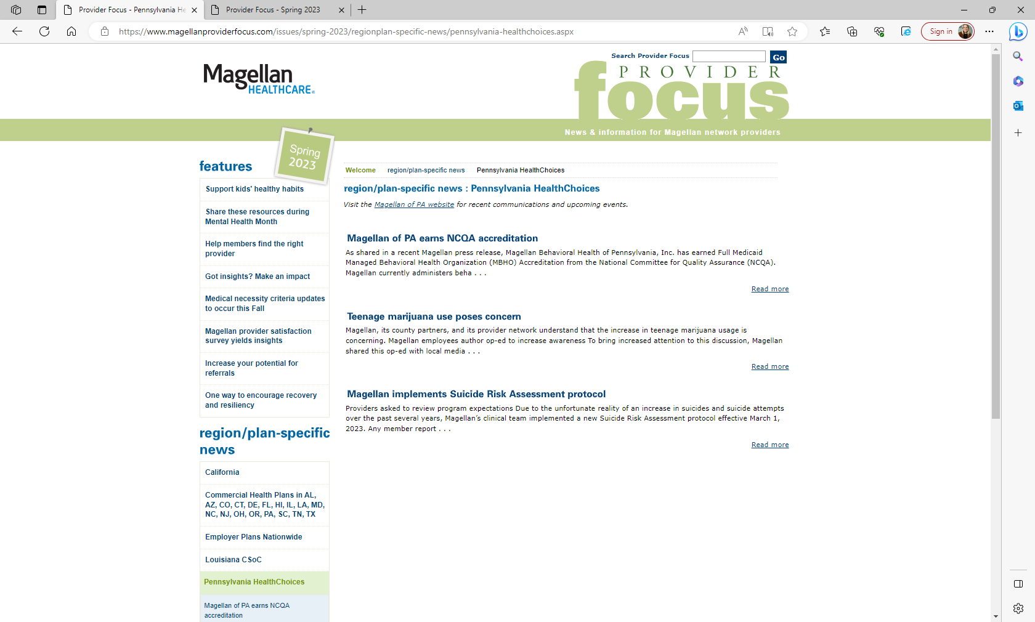
Online Newsletter: Provider Focus
Guideline changes are shared through the online newsletter, Provider Focus
Ability to search for region and plan-specific updates
  View “Pennsylvania HealthChoices” for updates specific to Magellan of PA
Notes:
Do a live walkthrough- slides are for resources post training

Slide 28


Slide 29
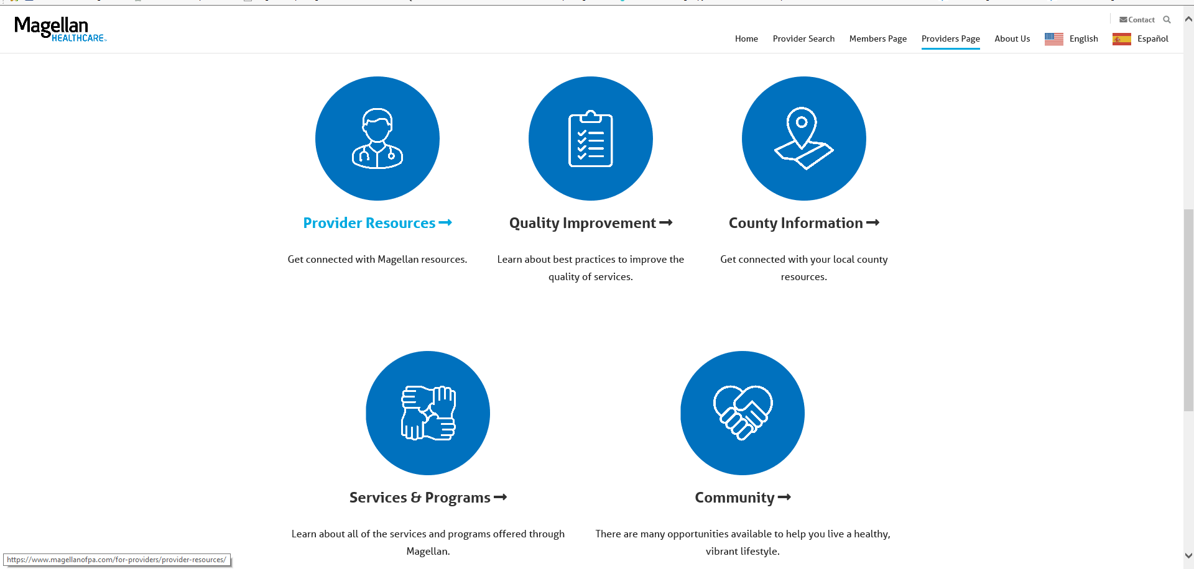

Slide 30
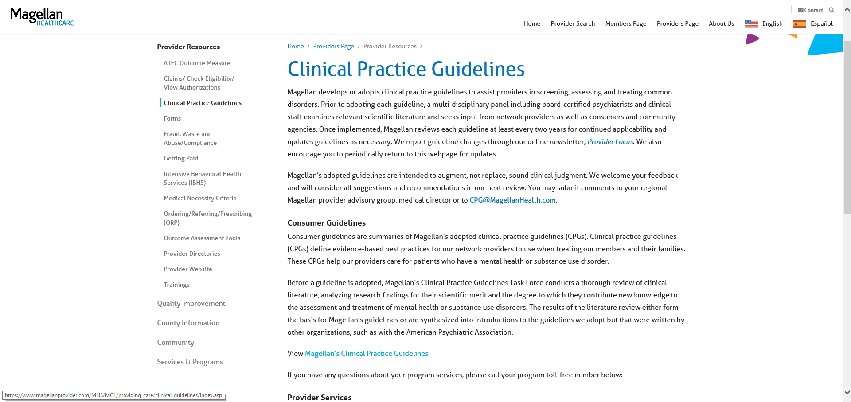

Slide 31
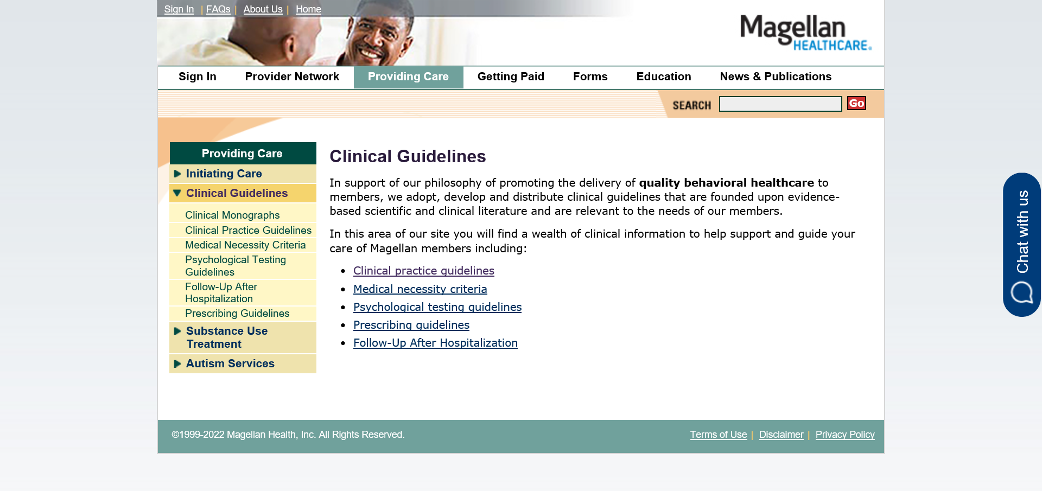

Slide 32
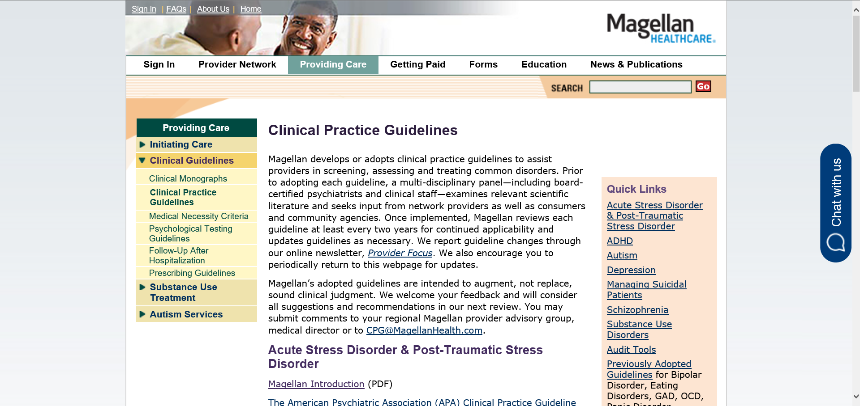

Slide 33
Homework!
Access the CPG website and send out a friendly reminder to all of your providers highlighting the provider focus and to encourage them to look at the most recent CPG guideline updates as reflected on our website

Slide 34
Questions?

Slide 36
Confidentiality statement
The information presented in this presentation is confidential and expected to be used solely in support of the delivery of services to Magellan members. By receipt of this presentation, each recipient agrees that the information contained herein will be kept confidential and that the information will not be photocopied, reproduced, or distributed to or disclosed to others at any time without the prior written consent of Magellan Health, Inc., a subsidiary of Centene Corporation.
The information contained in this presentation is intended for educational purposes only and should not be considered legal advice. Recipients are encouraged to obtain legal guidance from their own legal advisors.
Notes:
for providers

